Slide 1
Static Analysis

Slide 2
Static Tests
Static Testing, is a Testing technique in which we test the software document or software work products manually or by set of tools but with out executing the code. It has two parts as listed below:
Review (Manual Examination)- A review is a systematic examination of a document by one or more people with the main aim of finding and removing errors early in the SDLC. Reviews are used to verify documents such as requirements, system designs, code, test plans and test cases
Static analysis(Automated Analysis) – Static analysis tools are typically used by developers e.g compilers

Slide 3
Static Analysis
Static analysis, also called static code analysis, is a method of computer program debugging that is done by examining the code without executing the program.
The process provides an understanding of the code structure, and can help to ensure that the code adheres to industry standards.
Static analysis is one of the many code review tools that can be implemented without actually executing, or running, the software.
In static analysis, tools do the analysis e.g even spell checkers can be regarded as a form of static analyzers because they find mistakes in documents and therefore contribute to quality improvement.

Slide 4
Static Analysis
The document to be analyzed must follow a certain formal structure
In order to be checked by a tool. Static analysis makes sense only with the support of tools.
Static analysis tools are generally used by developers as part of the development and component testing process. The key aspect is that the code (or other artifact) is not executed or run but the tool itself is executed, and the source code we are interested in is the input data to the tool.
Formal documents can note, for example, the technical requirements, the software architecture, or the software design. An example is the modeling of class diagrams in UML Generated outputs in HTML or XML can also be subjected to tool-supported static analysis.
Formal models developed during the design phases can also be analyzed and inconsistencies can be detected

Slide 5
Static Analysis
Developers performs code analysis, they usually look for
Lines of code
Comment frequency
Proper nesting
Number of function calls
Cyclomatic complexity
Can also check for unit tests
Quality attributes that can be the focus of static analysis:
Reliability
Maintainability
Testability
Re-usability
Portability
Efficiency

Slide 6
Static analysis and reviews
Static analysis and reviews are closely related.
If a static analysis is performed before the review, a number of defects and deviations can be found and the number of the aspects to be checked in the review clearly decreases.
Due to the fact that static analysis is tool supported, there is much less effort involved than in a review.
If documents are formal enough to allow tool-supported static analysis, then it should definitely be performed before the document reviews because faults and deviations can be detected conveniently and cheaply and the reviews can be shortened.
Generally, static analysis should be used even if no review is planned. Each time a discrepancy is located and removed, the quality of the document increases.

Slide 7
Compiler is Static analysis tool
All compilers carry out a static analysis of the program text by checking that the correct syntax of the programming language is used.
Most compilers provide additional information, which can be derived by static analysis.
In addition to compilers, there are other tools that are so-called analyzers. These are used for performing special analysis or groups of analysis.

Slide 8
Compiler is Static analysis tool
The following defects and dangerous constructions can be detected by static analysis:
-> Syntax violations
-> Deviations from conventions and standards
-> Control flow anomalies
-> Data flow anomalies
Violation of the programming language syntax is detected by static analysis and reported as a fault or warning. Many compilers also generate further information and perform other checks which are:.

Slide 9
Compiler is Static analysis tool
Generating a cross-reference list of the different program elements (e.g., variables, functions)
Checking for correct data type usage by data and variables in programming languages with strict typing
Detecting undeclared variables
Detecting code that is not reachable (called dead code, It is a section in the source code of a program which is executed but whose result is never used in any other computation. The execution of dead code wastes computation time and memory)
Boundary value violations
Checking interface consistency
Detecting the use of all labels as jump start or jump target

Slide 10
Examination of Compliance to Conventions and Standards
Compliance to conventions and standards can also be checked with tools.
For example, tools can be used to check if a program follows programming regulations and standards. This way of checking takes little time and almost no personnel resources.
In any case, only guidelines that can be verified by tools should be accepted in a project. Other regulations usually prove to be bureaucratic waste anyway.
Furthermore, there often is an additional advantage: if the programmers know that the program code is checked for compliance to the programming guidelines, their willingness to work according to the guidelines is much higher than without an automatic test.

Slide 11
Execution of Data Flow Analysis
Data flow analysis is another means to reveal defects. Here, the usage of data on paths through the program code is checked.
An anomaly is an inconsistency that can lead to failure but does not necessarily do so. An anomaly may be flagged as a risk.
An example of a data flow anomaly is code that reads (uses) variables without previous initialization or code that doesn’t use the value of a variable at all. The analysis checks the usage of every single variable.

Slide 12
Data Flow Analysis
The following types of usage or states of variables and are distinguished as:
x is defined: d (defined)  The variable x is assigned a value (e.g. x = 5;)
x is referenced: r (referenced)  The value of the variable is read and/or used.
x is undefined: u (undefined)  The value of the variable x is deleted (e.g., deletion of local variables within a function or procedure at its termination). At program start all variables are undefined

Slide 13
Data Flow Analysis
We can distinguish three types of data flow anomalies:
ur-anomaly: An undefined value (u) of a variable is read on a program path (r).
du-anomaly: The variable is assigned a value (d) that becomes invalid/undefined (u) without having been used in the meantime.
dd-anomaly: The variable receives a value for the second time (d) and the first value had not been used (d).

Slide 14
Data Flow Analysis
Example of anomalies
We will use the following example (in C++) to explain the different anomalies. The following function is supposed to exchange the integer values of the parameters Max and Min with the help of the variable Help, if the value of the variable Min is greater that the value of the variable Max:
void exchange (int& Min, int& Max) {
int Help;
if (Min > Max) {
Max = Help;
Max = Min;
Help = Min;
}
}

Slide 15
Execution of Data Flow Analysis
After the usage of the single variables is analyzed, the following anomalies can be
detected:
ur-anomaly of the variable Help: The domain of the variable is limited to the function. The first usage of the variable is on the right side of an assignment. At this time, the variable still has an undefined value, which is referenced there. There was no initialization of the variable when it was declared (this anomaly
is also recognized by usual compilers, if a high warning level is activated).
dd-anomaly of the variable Max: The variable is used twice consecutively on the left side of an assignment and therefore is assigned a value twice. Either the first assignment can be omitted or the programmer forgot that the first value (before the second assignment) has been used.
du-anomaly of the variable Help: In the last assignment of the function, the variable Help is assigned another value that cannot be used anywhere because the variable is valid only inside the function.
In this example, the anomalies are obvious.
The anomalies would not be as obvious anymore and could easily be missed by a manual check such as, for example, a review. A tool for analyzing data flow can, however, detect the anomalies.
Not every anomaly leads directly to an incorrect behavior. For example, a du-anomaly does not always have direct effects; the program could still run properly.

Slide 16
Execution of Control Flow Analysis
Control flow testing uses the control structure of a program to develop the test cases for the program.
The test cases are developed to sufficiently cover the whole control structure of the program.
The control structure of a program can be represented by the control flow graph of the program.

Slide 17
Control Flow Anomalies
If parts of the graph or the whole graph are very complex, then the program text should be revised, because complex sequence structures often bear a great risk of being wrong and it increases risk of errors in code.
These anomalies could be jumps out of a loop body or a program structure that has several exits. They may not necessarily lead to failure, but they are not in accordance with the principles of structured programming.
Another type of anomaly is when a program structure, such as a function or loop, has multiple exit points. Multiple exits can make the program's control flow more complex and harder to understand.
The CFG is assumed to be generated automatically by a tool that accurately maps the program text to the graph. This ensures that the CFG reflects the actual control flow of the code and allows for accurate analysis of control flow anomalies.

Slide 18
Control Flow Graph
If parts of the graph or the whole graph are very complex and the relations, as well as the course of events, are not understandable, then the program text should be revised, because complex sequence structures often bear a great risk of being wrong.
The control flow graph G = (N, E) of a program consists of a set of nodes N and a set of edge E.
Each node represents a set of program statements. There are five types of nodes. There is a unique entry node and a unique exit node.

Slide 19
Control Flow Graph
A decision node contains a conditional statement that creates 2 or more control branches (e.g. if or switch statements).
A merge node usually does not contain any statement and is used to represent a program point where multiple control branches merge.
A statement node contains a sequence of statements. The control must enter from the first statement and exit from the last statement.

Slide 20
Control Flow Graph: Nodes
A decision node contains a conditional statement that creates 2 or more control branches (e.g. if or switch statements).
A merge node usually does not contain any statement and is used to represent a program point where multiple control branches merge.
A statement node contains a sequence of statements. The control must enter from the first statement and exit from the last statement.

Slide 21
Test Case and Test Coverage
A test case is a complete path from the entry node to the exit node of a control flow graph.
A test coverage criterion measures the extent to which a set of test cases covers a program.

Slide 22
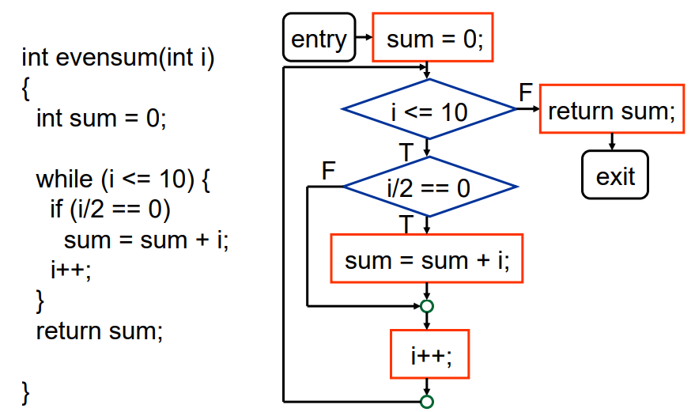
Control Flow Graph: Example 1

Slide 23
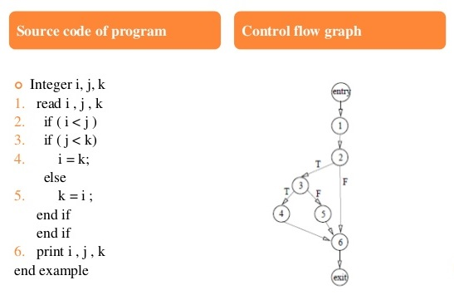
Control Flow Graph: Example 2

Slide 24
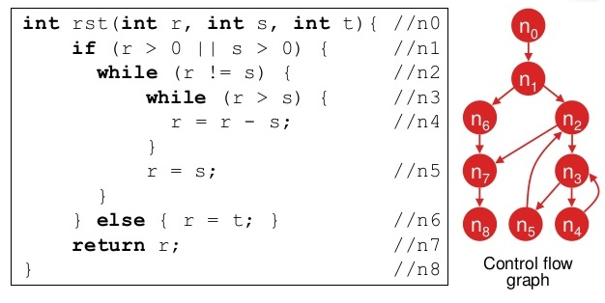
Control Flow Graph: Example 3

Slide 25
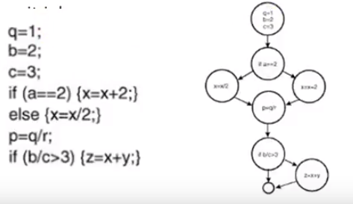
Control Flow Graph: Example 4 with junction point

Slide 26
Software Metric
Quantitative measures used to assess the quality, effectiveness, and efficiency of the testing process, as well as the quality of the software being tested.
These metrics help testers and project stakeholders to make informed decisions regarding the testing effort, resource allocation, and overall software quality.

Slide 27
Cyclomatic Complexity
Cyclomatic complexity is a software metric used to measure the complexity of a program’s CFG.
This metric measures the structural complexity of program code.
It also measures independent paths through the program's source code. An independent path is defined as a path that has at least one edge which has not been traversed before in any other paths.
Cyclomatic complexity can be calculated with respect to functions, modules, methods or classes.
The cyclomatic number gives information about the testing effort

Slide 28
Cyclomatic Complexity
Cyclomatic Complexity for a flow graph is computed in one of three ways:
Cyclomatic complexity, V(G), for a flow graph G is defined as V(G) = E – N + 2
Cyclomatic complexity, V(G), for a graph flow G is also defined as V(G) = P + 1 where P is the number of predicate nodes contained in the flow graph G.
The numbers of regions of the flow graph correspond to the cyclomatic complexity.

Slide 29
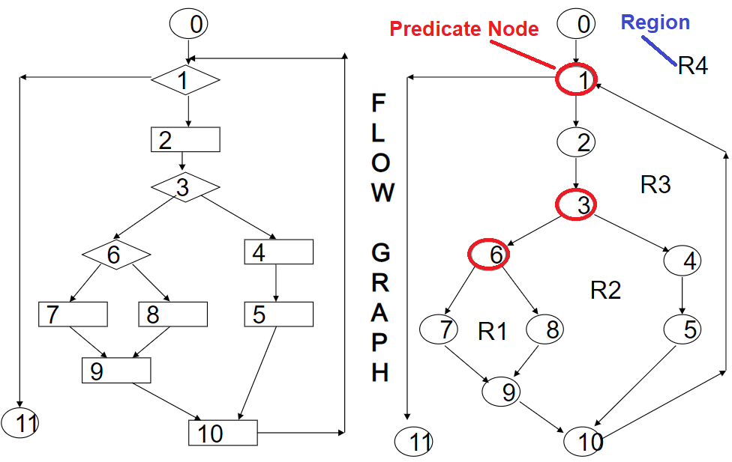
Flow Graph Notation
Here R1,R2, R3 and R4 are the regions
Nodes 1, 3 and 6 are the predicate nodes

Slide 30
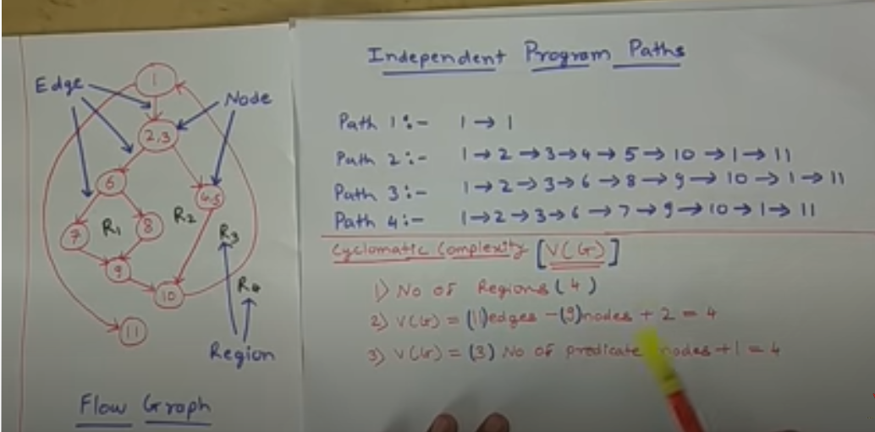
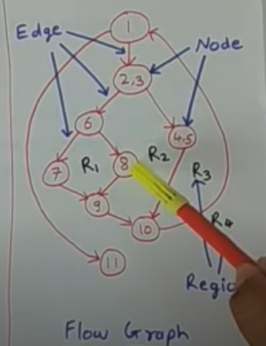
Cyclomatic Complexity
Cyclomatic complexity can be calculated with the help of three ways
No of regions= closed regions= 4
V(G)= E-N+2 = 11-9+2=4
V(G)= N0. of predicate nodes+1= 3+1=4 (Here predicate nodes r those in flow graph where decision is made i.e from where we decide to go in this example {1}, {2,3} and {6} nodes are the predicate nodes i.e v have 3 predicate nodes.

Slide 31
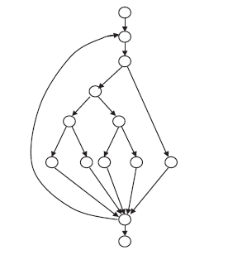
Cyclomatic Complexity
A program part is represented by the graph below so It is a function that can be called. Thus, the cyclomatic number can be calculated like this:
v (G) = e - n + 2 = 17 - 13 + 2 =6
e = number of edges in the graph = 17
n = number of nodes in the graph = 13
(The value of 6 is, according to McCabe, acceptable and in the middle of the range. He assumes that a value higher than 10 cannot be tolerated and rework of the program code has to take place.)

Slide 32
Cyclomatic Complexity Number’s
Complexity Number | Meaning
1-10 | Structured and well written code High Testability Cost and Effort is less
10-20 | Complex Code Medium Testability Cost and effort is Medium
20-40 | Very complex Code Low Testability Cost and Effort are high
>40 | Not at all testable Very high Cost and Effort

Slide 33
Tools for Determining Complexity
OCLint - Static code analyzer for C and Related Languages
devMetrics - Analyzing metrics for C# projects
Reflector Add In - Code metrics for .NET assemblies
GMetrics - Find metrics in Java related applications
NDepends - Metrics in Java applications

Slide 34
Uses of Cyclomatic Complexity
Helps developers and testers to determine independent path executions
Developers can assure that all the paths have been tested at least once
Helps us to focus more on the uncovered paths
Improve code coverage
Evaluate the risk associated with the application or program
Using these metrics early in the cycle reduces more risk of the program

Slide 35
Independent Paths
Independent path:
An executable or realizable path through the graph from the start node to the end node that has not been traversed before.
Must move along at least one arc that has not been yet traversed (an unvisited arc).
The objective is to cover all statements in a program by independent paths.
The number of independent paths to discover <= cyclomatic complexity number.
Decide the Basis Path Set:
It is the maximal set of independent paths in the flow graph.
NOT a unique set.

Slide 36
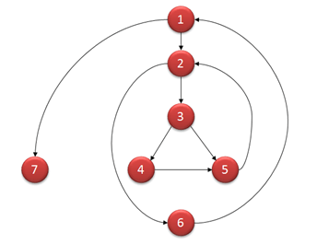
Basis Path testing
Basis Path testing is one of White box technique and it guarantees to execute at least one statement during testing. It checks each linearly independent path through the program, which means number test cases, will be equivalent to the cyclomatic complexity of the program.
V(G) = 9 - 7 + 2 = 4
Basis Set - A set of possible execution
path of a program
1, 7
1, 2, 6, 1, 7
1, 2, 3, 4, 5, 2, 6, 1, 7
1, 2, 3, 5, 2, 6, 1, 7

Slide 37
Basis Path Testing
The following steps should be followed for computing Cyclomatic complexity and test cases design.
Step 1 - Construction of graph with nodes and edges from the code
Step 2 - Cyclomatic Complexity Calculation
Step 3 - Identification of independent paths
Step 4 - Design of Test Cases to exercise each path

Slide 38
Benefits of Basis Path Testing
It helps to reduce the redundant tests
It focuses attention on program logic
It helps facilitates analytical versus arbitrary case design
Test cases which exercise basis set will execute every statement in program at least once

Slide 39
Draw Control Flow Graph for the following
source codes and Calculate Cyclomatic Complexity

Slide 40
Example 1
If A= 40
Then if B>C
Then A=B
Else A=C
Endif
Endif
Print A

Slide 41
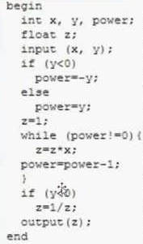
Example 2

Slide 42
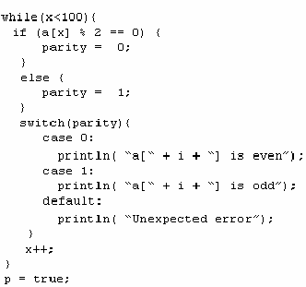
Example 3

